Slide 1
RENEWABLE ENERGY ANALYSIS
August
2020
Contributors:
Curtis Caile, Dave Borowski, Brooke Crofts

Slide 2
From: Gas and Oil To: Solar and Wind
Where natural weather trends promote use of renewable energy sources

Slide 3
Project Outline
Identify data sources for renewable energy.
Write APIs to collect and store data
Identify trends by region using matplotlib/pandas
Heat maps of output by energy source
Using open weather data to identify wind/sun trends

Slide 4
Where our interests started:
Where is wind/solar most efficient?
Understand Historic output/use of solar energy
What country/state produces the most renewable energy?
Can we identify areas that have weather conditions suitable for renewables?

Slide 5
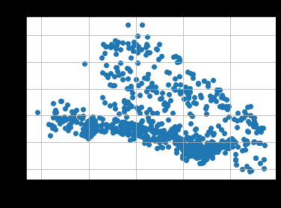
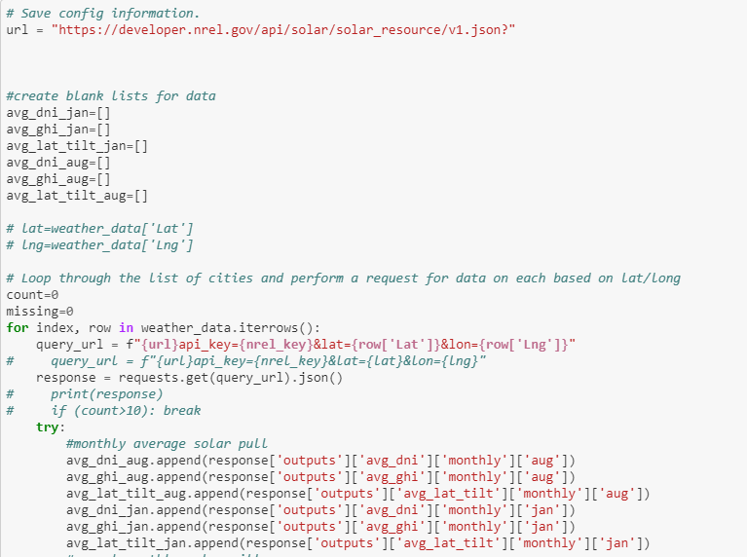
For Loop API Call

Slide 6
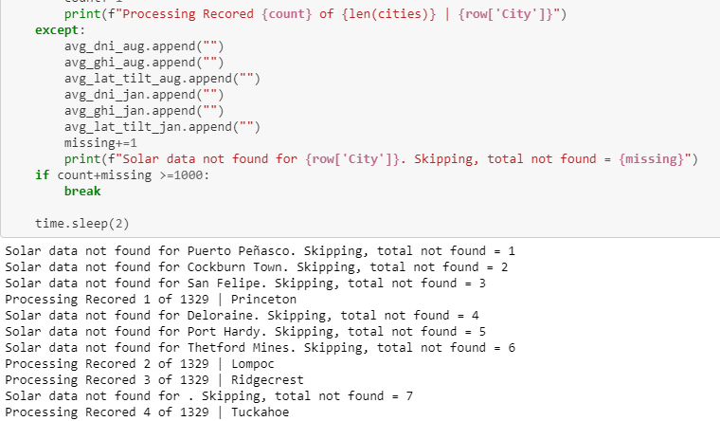
For Loop API Call

Slide 7
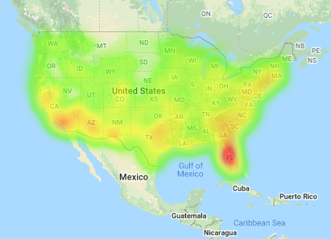
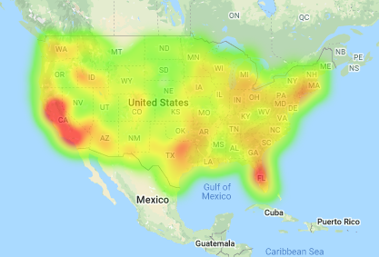
COMPARISONS
Heat Map Visualization of Average DNI output in January/August
January
August

Slide 8
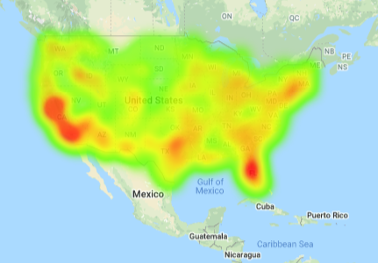
Heatmap – Jan/Aug Overlay
Top Ten States with Highest Solar Output
California – 21,074 MW
North Carolina – 4,308 MW
Arizona – 3,400 MW
Nevada – 2,595 MW
New Jersey – 2,390 MW
Massachusetts – 2,011 MW
Texas – 1,874 MW
Utah – 1,599 MW
Georgia – 1,566 MW
Florida – 1,430 MW

Slide 9
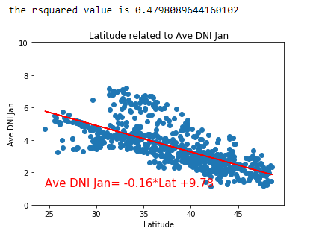
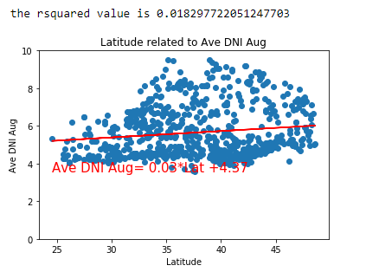
Average Direct Normal Irradiance - The values returned are kWh/m²/day (kilowatt hours per square meter per day). The insolation values represent the resource available to concentrating systems that track the sun throughout the day.

Slide 10
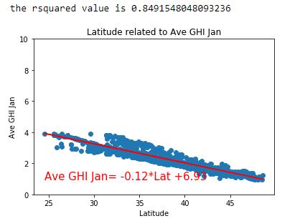
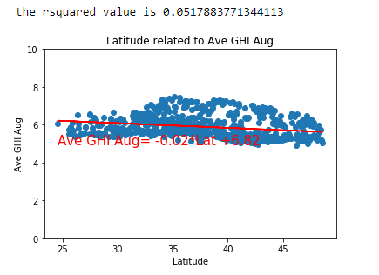
Average Global Horizontal Irradiance - The insolation values represent the global horizontal resource - the geometric sum of direct normal and diffuse irradiance components, representing total energy available on a planar surface.

Slide 11
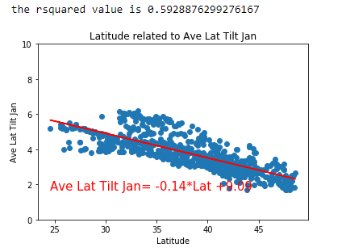
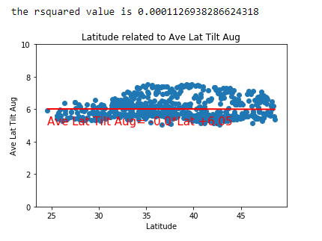
Average Tilt at Latitude - The insolation values represent the resource available to fixed flat plate system tilted towards the equator at an angle equal to the latitude.

Slide 12
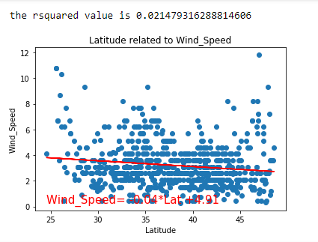
August 1, 2020 Wind Speed
Historical Data on Open Weather Data proved to be too cost prohibitive to do an adequate study on wind data and our hope to show areas that may have natural weather patterns to harness wind energy.

Slide 13
Project Data Index
National Renewable Energy Lab: https://developer.nrel.gov/docs/solar/solar-resource-v1/
Open Weather Data: http://api.openweathermap.org/data/2.5/weather?”
Vivint.Solar: https://www.vivintsolar.com/learning-center/top-states-for-solar

Slide 14
THANK YOU!
Curtis Caile, Dave Borowski, Brooke Crofts
DU Bootcamp 2020

